Slide 1
Enhancing Brain Tumor Detection: A Comprehensive Analysis of ResNet-based Convolutional Neural Networks
Research/Project Presentation
by
Amit Kumar
Department of Computer Science & Engineering
Manipal Institute of Technology, Manipal
Under the supervision of
Dr. Renuka A
Professor, Dept. of Computer Science and Engineering
Manipal Institute of Technology, Manipal
February 15, 2024

Slide 2
Presentation overview
Introduction
Major Challenges & Motivation
Literature Review
Problem Definition
Research Gaps Identified
Research Objectives
Methodology
Dataset
Result Analysis
Expected Outcomes
Conclusion
Importance of Proposed Research
Future Scope
Journal/Conference Identified
References

Slide 3
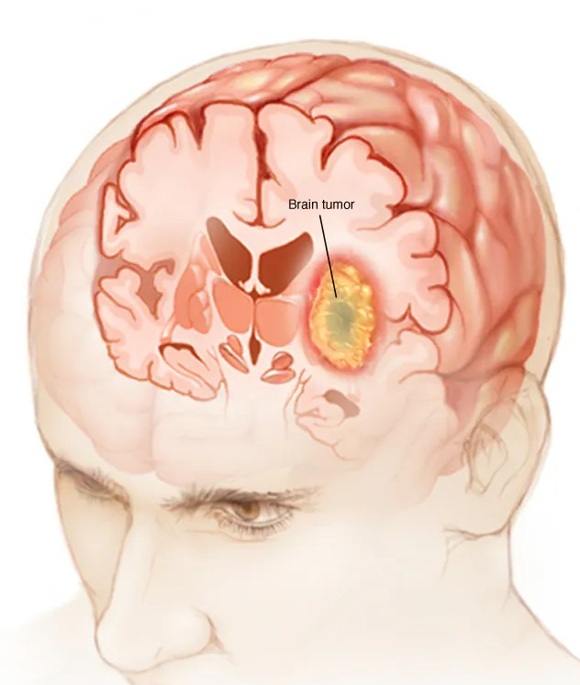
Brain Tumor - Introduction
Brain tumors are abnormal growths of cells within the brain that can either be benign or malignant.
Detecting brain tumors early is crucial for effective treatment and improving patient outcomes.
Traditional methods of brain tumor detection like MRI and CT scans are often expensive and require specialized equipment.
In recent years, there has been growing interest in developing automated and non-invasive techniques for detecting brain tumors using machine learning and artificial intelligence (AI) algorithms.
These techniques leverage the vast amounts of medical data available to train models that can accurately identify and classify brain tumors from various imaging modalities.

Slide 4
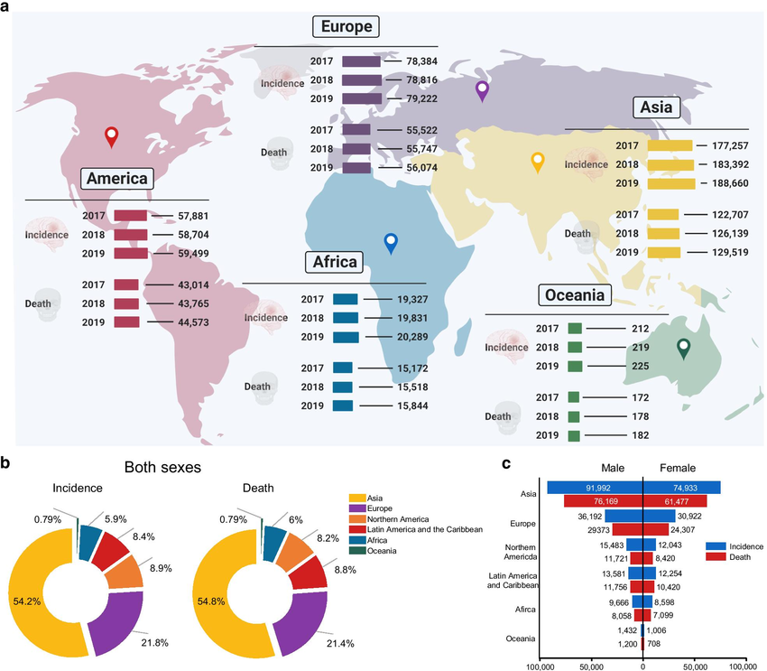
Brain Tumor Detection – Global view
Global map showing the incidence and death related to brain tumors across the world from 2017-2019.
Pie chart presents the distribution of incidence and deaths related to brain tumors in major world regions in 2020 for both sexes and all ages.
Bar graph reveals the incidence of brain tumor and corresponding deaths in 2020 in males and females.
Global health data exchange and GLOBALCAN 2020 at the Global Cancer Observatory(GCO)

Slide 5
Brain Tumor Detection – Major Challenges
Tumor Heterogeneity: consist of a mixture of different cell types and genetic mutations.
Size and location : Brain tumors can vary widely in size, shape, location, and appearance.
Limited healthcare workforce: shortage of trained medical doctors can hinder timely and accurate diagnoses.
Imaging limitations: even high-resolution imaging techniques like MRI may miss small tumors.

Slide 6
Motivation
Improved survival rates
Enhanced quality of life
Medical advancements
Reduced healthcare costs
Efficient resource allocation

Slide 7
Literature Review
Author | Classification Method | Accuracy
El-Dahsan et al. | FP-ANN | 97%
 | K-NN | 98.60%
Sawant et al. | CNN | 98.60%
Abdalla et al. | ANN | 99%
Islam et al. | Tk-means clustering | 95%
Rai et al. | LU-Net | 98%
Kang et al. | DenseNet-169 | 92.37%
 | ResNeXt-101 | 96.13%
Literature Review of papers

Slide 8
Problem Definition
Brain tumors are a serious and potentially life-threatening condition, and their early and accurate detection is crucial for effective treatment and improved patient outcomes. However, manual analysis of medical imaging data, such as Magnetic Resonance Imaging (MRI) scans, is a time-consuming and subjective process, prone to human errors and variability. To address these challenges, the proposed research aims to develop and evaluate a deep learning-based approach for brain tumor detection using Convolutional Neural Networks (CNNs) with a Residual Network (ResNet) architecture.

Slide 9
Research Gaps Identified
The idea is to further classify the brain tumor by exploring various architectures of the ResNet-based family of convolutional neural networks:-
ResNet-18
ResNet-34
ResNet-50
ResNet-101
ResNet-152
Augmentation of dataset by increasing the pixel resolution of the images, flipping and scaling can be approached.

Slide 10
Research Objectives
The aim is to construct a user-friendly classification algorithm that categorizes the data into different groups and classify helps to predict the disease.
The specific goals of this research work are to
Improve the accuracy of disease prediction
Reduce the need for invasive or expensive tests
Make disease prediction more accessible and classification more feasible
Facilitate early intervention

Slide 11
Methodology - ResNet
ResNet introduces a novel architecture that includes residual blocks, allowing for the successful training of extremely deep neural networks.
A) ResNet, short for Residual Network, composes of foundational units known as residual blocks. Every residual block has a skip connection (or short connection) that allows the input to bypass one or more hidden layers and directly reach the output.
B) These skip connections in a residual block make it possible to learn an identity mapping, meaning the output layer is the same as the input layer.
C) ResNet introduces the idea of residual learning, where the aim is to learn the gap between the input fed to the network and the output of the net-work in a block. This difference is then added to the input to obtain the final output.
D) ResNet encourages the stacking of multiple residual blocks to create very deep networks. This architecture allows the network to be trained with a substantial number of layers ranging from hundreds to thousands.
E) A distinctive aspect of residual networks’ design philosophy is Global Average Pooling (GAP). Its effectiveness is in simplifying model and to prevent overfitting by taking average of all values in a feature map.

Slide 12
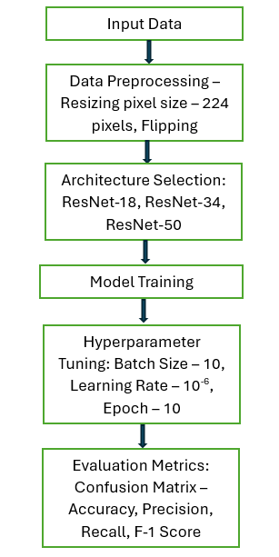
Methodology – Frameworks Used
Architecture | Key Features
ResNet-18 | 18-layer deep network Residual blocks with skip connections
ResNet-34 | 34-layer deep network Residual blocks with bottleneck architecture
ResNet-50 | 50-layer deep network Balance between model complexity and computational efficiency
ResNet-101 | 101-layer deep network Utilizes the bottleneck architecture
ResNet-152 | 152-layer deep network Enhances feature learning
Wide Residual Network(WRN) | Increased model width for improved feature learning Emphasizes on parameter efficiency
ResNeXt-50 | 50-layer deep network Multiple parallel paths within residual block
ResNeXt-101 | Similar to ResNeXt50, but with 101-layer deep network Employs bottleneck architecture
ResNet-based CNN architectures
Steps to be followed

Slide 13
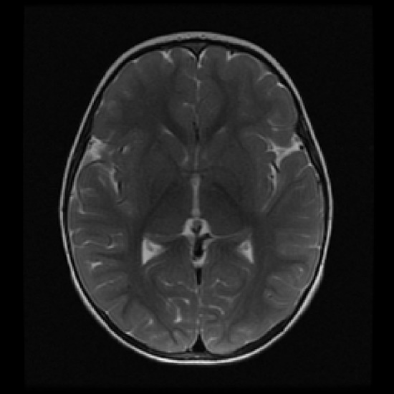
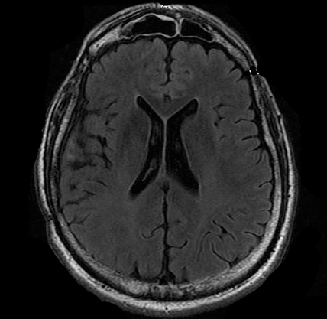
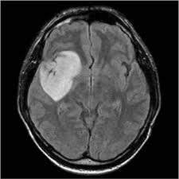
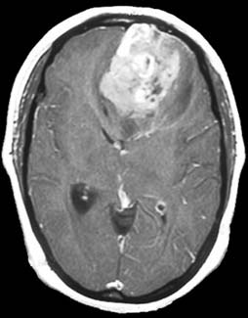
Dataset
The dataset selected is ‘Brain MRI Images for Brain Tumor Detection’ comprising of 253 MR images obtained from Kaggle.
Data augmentation by resizing images to a pixel count of 224*224 and flipping images vertically and horizontally randomly.
Tumor Absent
Tumor Present

Slide 14
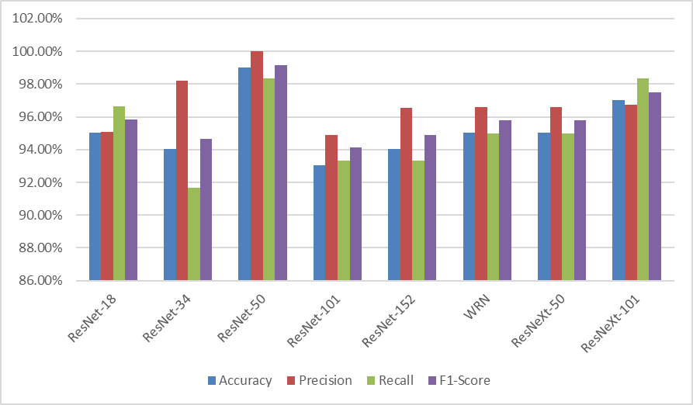
Result Analysis
The significant outcomes expected of the proposed system are as follows:
The various ResNet-based CNN algorithms are used to determine whether the patient has brain tumor or not.
Based upon the results, the convolution matrix is plotted and the various metrics such as accuracy, precision, recall and f-1 score are computed.

Slide 15
Expected Outcomes
This paper aims to provide a thorough investigation into the application of ResNet-based convolutional neural networks (CNNs) for improving the detection of brain tumors.
Comprehensive evaluation of different variants of ResNet architectures(e.g., ResNet18, ResNet50, ResNet101).
Investigate various training strategies such as data augmentation, transfer learning, fine-tuning hyperparameters and optimization techniques.

Slide 16
Conclusion
In summary, this research systematically explores the utilization of convolutional neural networks (CNNs), particularly focusing on various residual networks (ResNets), to enhance brain tumor detection.
The study delves into the intricate domain of medical image analysis, addressing the challenges associated with the swift and accurate identification of brain tumors.
By deepening our understanding of the capabilities and nuances of ResNet-based CNNs in this context, the paper lays a groundwork for continuous advancements at the intersection of machine learning and medical diagnostics.

Slide 17
Importance of Proposed Research
According to American Brain Tumor Association(ABTA), approximately 90,000 people are diagnosed with a primary brain tumor every year.
Brain and other central nervous system(CNS) tumors are the fifth most common cancer.
Over 1 million people are living with a diagnosis of primary brain tumor.
The process of manually identifying brain tumors relies highly on the expertise of radiologists, and can be prone to inconsistencies due to subjective interpretation and lacks repeatability.
The substantial volume of imaging data per patient makes manual assessment a time-consuming task.

Slide 18
Future Scope
The future prospects for user-friendly algorithms in brain tumor detection are marked by continuous innovation and integration with emerging technologies, aiming to enhance healthcare accessibility and outcomes globally.
There exists significant potential to improve the sophistication and precision of these algorithms through ongoing advancements in machine learning and artificial intelligence research.
As algorithms continue to evolve in their ability to analyze intricate datasets and detect subtle patterns, they are poised to offer enhanced predictive abilities across a broader spectrum of brain tumor types.

Slide 19
Journal/Conference Identified
IEEE CFP CISCON-2024
MPCIT-2024

Slide 20
References
P.K. Chahal, S. Pandey, and S. Goel, “A survey on brain tumor detection techniques for MR images,”Multimedia Tools Appl., vol. 79 , nos. 29-30, pp. 21771-21814, May 2020.
Muhammad, S. Khan, J.D. Ser, and V.H.C.D. Albuquerque, “Deep learning for multigrade brain tumor classification in smart healthcare systems: A prospective survey,” IEEE Trans. Neural Netw. Learn. Syst., vol. 32, no. 2, pp. 507-522, Feb 2021.
E.S.A. El-Dahsan, T. Hosny, and A.B.M. Salem, “Hybrid intelligent techniques for MRI brain images classification,” Digit. Signal Process., vol. 20, pp. 433-441, Mar. 2010.
T.K. Das, P.K. Roy, M. Uddin, K. Srinivas, C.-Y. Chang, and S. Syed-Abdul, “Early tumor diagnosis in brain MR images via deep convolutional neural network model,” Comput., Mater. Continua, vol. 68, no. 2, pp. 2413-2429, 2021.
K. Simonyan and A. Zisserman, “Very deep convolutional neural networks for large-scale image recognition,”Sep. 2014, arXiv:1409.1556.
G. Huang, Z. Liu L. van der Maaten,and K.Q. Weinberger, “Densely connected convolutional networks,” inProc. IEEE Conf. Comput. Vis. Pattern Recognit. (CVPR), Honolulu, HI, USA, Jul. 2017, pp. 2261-2269.
7. S.R. Telrandhe, A. Pimpalkar, and A. Kendhe, “Detection of brain tumor from MRI images by using segmentation & SVM,” in Proc. World Conf. Futuristic Trends Res. Innov. Social Welfare (Startup Conclave), Coimbatore, India, 2016, pp. 1-6.

Slide 21
Thank You ☺

